Slide 1
The Modern Software Developer
CS146S
Stanford University, Fall 2025
Mihail Eric
themodernsoftware.dev

Slide 2

Guest Lecture - 10/24/25
CEO of Warp, Zach Lloyd
themodernsoftware.dev

Slide 3
Building a breakout AI developer product
themodernsoftware.dev
Notes:
Use warp as the demonstration tool

Slide 4
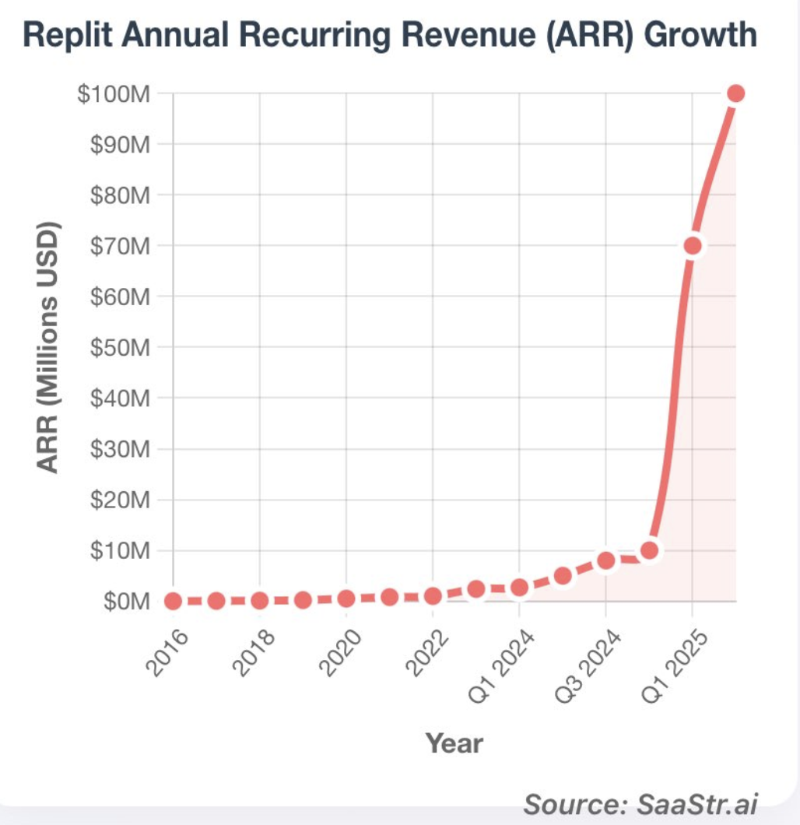
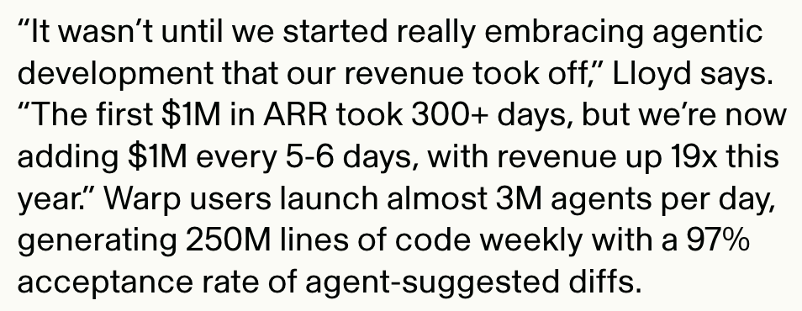
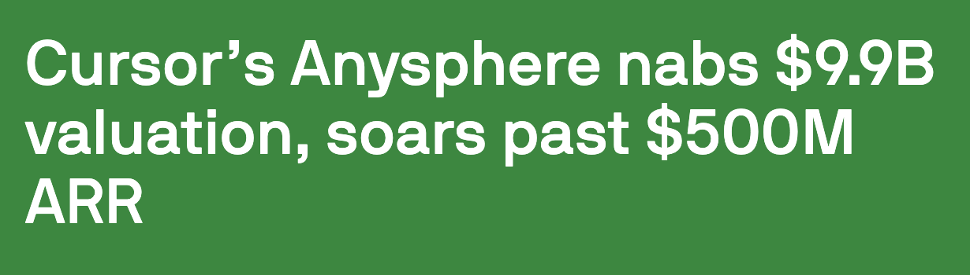
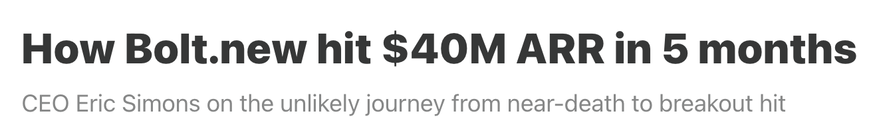
Why
We’re seeing some of the fastest adoption of new dev tools in history
themodernsoftware.dev

Slide 5
Why
The UX/UI for developer tools are changing rapidly to best leverage agentic autonomy
What does having agents in your developer environment change about the product you are using?
themodernsoftware.dev

Slide 6
7 Product Principles of Modern AI Dev Tools
themodernsoftware.dev
Notes:
How many people use the terminal here?
Show the native mac terminal app
Let’s bring it all together

Slide 7
Start with what developers know
Encourage transition from existing interfaces
Everyone uses an IDE (Cursor)
Terminal is well-understood UX (Warp)
People know chat (Bolt)
Easily switch between code and natural language
themodernsoftware.dev
Notes:
https://explainshell.com/explain as a starting point
Align behind a shared universal painpoint
“Tar -czvf” example
Weaning off the commandline interface

Slide 8
Configuration flexibility
Zero setup required to demonstrate value for average user
Swap between models seamlessly
Tremendous configurability for power user
Prompts
Project rules
MCP
themodernsoftware.dev
Notes:
Warp profiles per user

Slide 9
Focus on developer ergonomics
If you can shave off a single keystroke, do it
Keyboard hotkeys
Zero onboarding friction
“5 minutes to WOW”
themodernsoftware.dev
Notes:
Stickiness of “tab”, “enter” features

Slide 10
Chat as a first-class citizen
Code is inherently a contrived representation of human intent
As tools evolve, more of them will involve just speaking in natural language
Progress toward simply communicating developer intent rather than syntax
themodernsoftware.dev
Notes:
Debugging an error in Warp

Slide 11
MCP Integration
MCP has become the lingua franca for allowing LLMs to interact with the real-world
Extensible tool ecosystem to give LLMs access to any resource and ability to do anything
themodernsoftware.dev
Notes:
Show how Warp integrates with MCP
Show example of using context7 for up-to-date braintrust

Slide 12
Rapid feedback loops
Allow iterating on changes and seeing updates quickly
Panels and dashboards that change in near real-time based on prompts
This is why entire projects are committed to just reducing build time
Explainability is first-class citizen
themodernsoftware.dev
Notes:
Real-time update canvas in Bolt/Lovable
Warp take action and immediate reaction to that action
You see the effects of your changes

Slide 13
Agent Workflows
Full autonomy for substantive tasks
Increasing adoption of an “agent-take-the-wheel” approach
Varied levels of human-in-the-loop involvement
Agent asks clarifying questions
YOLO
themodernsoftware.dev
Notes:
Show yolo mode in Warp

Slide 14
Open Questions
Will we see massive consolidation from point solutions (for code review, app building, monitoring) into a single all-in-one platform?
Will AI IDEs just evolve into AI terminals into AI browser replits?
Will tools like Warp/Cursor become more verticalized, specializing their offering for tasks like full stack development?
What universal standard will emerge for personalizing your coding agents and giving them project-specific rules?
We won’t be in a fragmented .cursorrules / CLAUDE.md / etc world for long.
AGENTS.md is a first step in that direction
themodernsoftware.dev

